Slide 1
IGNITION SYSTEM
Department of Mechanical Engineering
Pulchowk Campus, Institute of Engineering
Tribhuvan University

Slide 2
CONTENTS
Purpose
Types of ignition system
Battery ignition system
Main components and their functions
Drawbacks of conventional battery ignition system
Magneto ignition system
Electronic ignition system
Conclusions

Slide 3
PURPOSE
The ignition system ignites the compressed air-fuel mixture at proper time (the end of compression stroke) and initiate combustion.
This is achieved by means of electric spark, i.e. a brief arc discharge between the electrodes of the spark plug.
Energy required to ignite an air-fuel mixture by means of electric sparks:
  Stroichiometric mixture: approx. 0.2 mJ
  Rich or lean mixture: > 3 mJ
  Actual energy used > 50 mJ and duration > 0.5 ms
The sparking rate per minute (f) in 4-stroke SI engine is as follows:
  f = z.n/2, where z – number of cylinders, n – engine speed
Notes:
Actual air-fuel mixture is not homogeneous and it contains air, fuel and recycled exhaust gas. Also the pressure, temperature and density of the mixture between the spark plug electrodes at the time the spark is needed affect the voltage required to produce a spark.

Slide 4
IGNITION SYSTEM
Major two Jobs:
Change battery voltage (12V) into high voltage spark 60,000 volts.
Delivers the high voltage to the correct cylinder at the correct time.

Slide 5
Ignition system-SI.exe

Slide 6
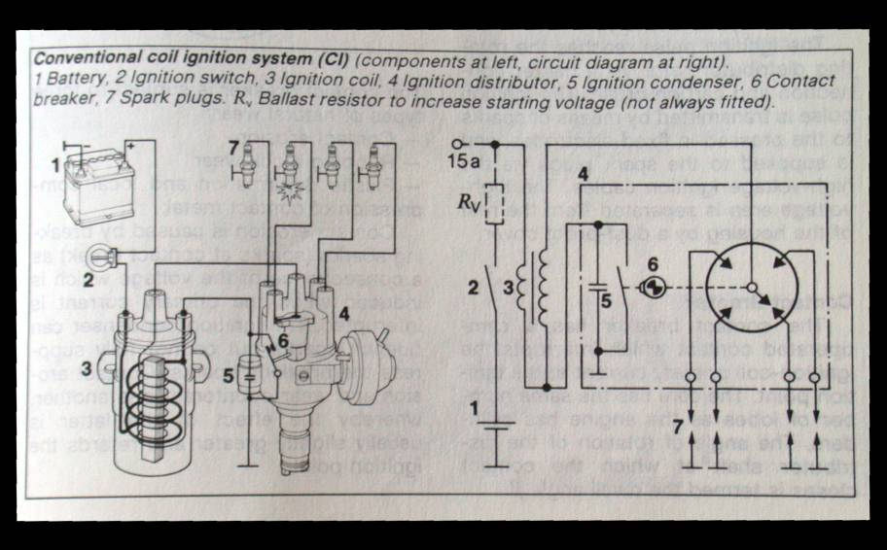
Schematic diagram of battery ignition system

Slide 7
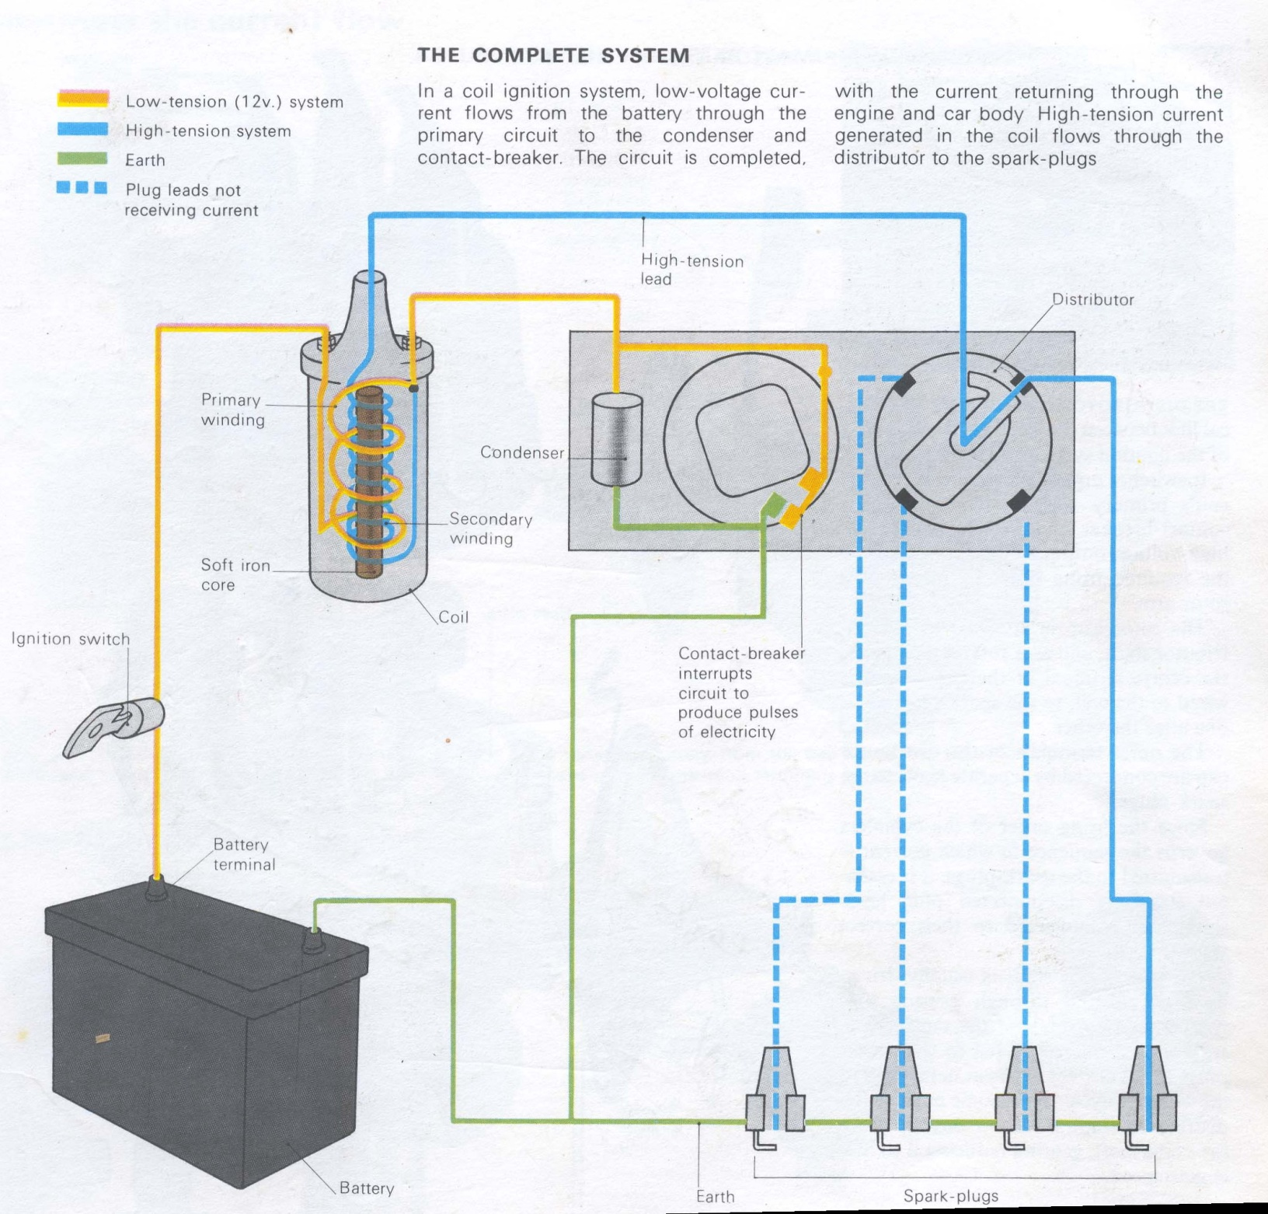

Slide 8
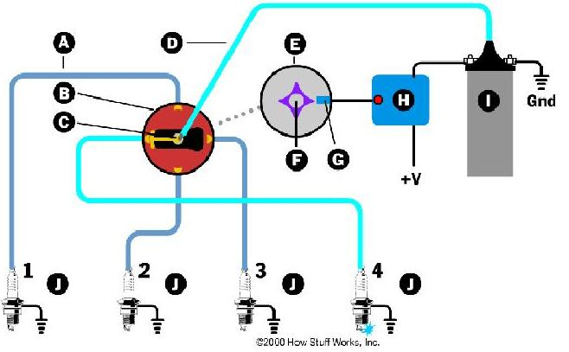

IGNITION SYSTEM (SI ENGINE)

Slide 9
PRIMARY CURRENT
The primary current for any given time of contact closure t is given by
I_{p} = V_{o}/R *(1 – e^{–Rt/Lp})
Where;
I_{p} – the primary current,
V_{o} – the supply voltage,
R – the total primary circuit resistance
Lp – the primary circuit inductance
The primary current requires time to build up. At low speeds the time of contact closure is sufficient for the primary current to reach the maximum permitted by the circuit resistance; at higher speeds the primary current may not reach its maximum. Thus, only at higher engine speeds does the term e^{-Rt/Lp} becomes significant.
Notes:
The primary current requires time to build up. Ip = 4A is acceptable for longer life of contact breaker points. Increased currents cause a rapid reduction in breaker point life and system reliability.

Slide 10
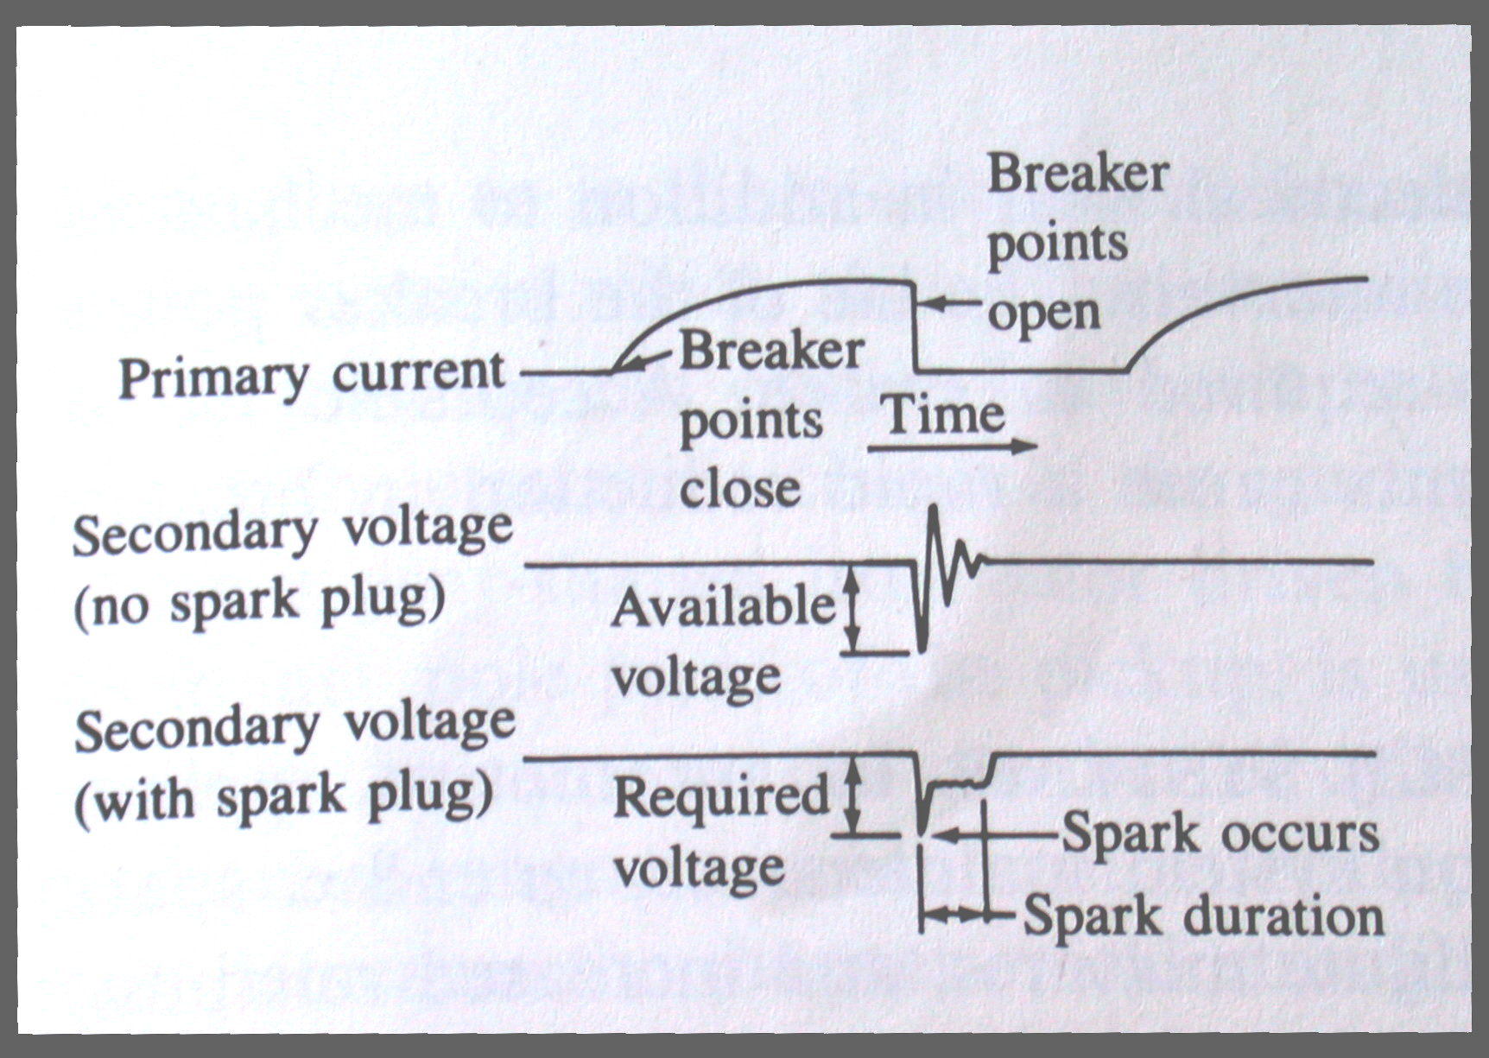
Notes:
When the points open the primary current falls to zero and a voltage of order 15 kV is induced in the secondary winding. If the coil is not connected to a spark plug, this induced voltage will have a damped sinusoidal waveform, as shown in the center trace. The peak value of this voltage is the maximum voltage that can be produced by the system and is called the available voltage Va of the system (Heywood, 1988).

Slide 11
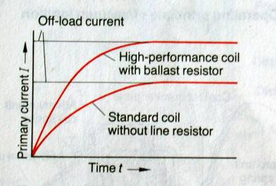
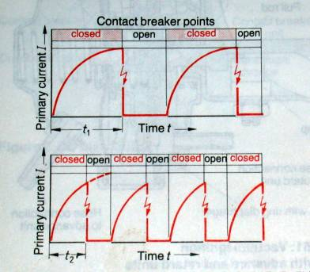
PRIMARY CURRENT AT VARIOUS SPARK RATES
In order to achieve a higher rate of sparks per minute and a higher ignition voltage, it is necessary for the primary current to be increased and to rise more rapidly.
During operation, the primary current flows only for short periods, since the CB points are continually opening and closing. In addition, the self-induced voltage prevents the maximum primary current value from being reached; this primary current is referred to as the off-load current.
Notes:
A higher primary current causes greater heat losses in the primary winding. In order to stabilize the off-load current of the coil, the primary current has to be limited by a 1 or 2 Ohm ballast resister. This relieves the thermal load on the coil, since part of the heat generated by the current occurs in the resistor and can easily be dissipated.

Slide 12
TWO CIRCUITS OF IGNITION SYSTEM
Primary circuit- Low voltage circuit.
It creates a magnetic field.
Secondary circuit- High voltage circuit.
Delivers the high voltage to correct cylinders.

Slide 13
PARTS OF THE PRIMARY CIRCUIT
1) Battery- Supplies electrical power for circuit.
2) Ignition switch-Turns on or shuts off the circuit.
3) Resistor- Reduces the voltage flowing through the circuit.

Slide 14
4) Primary windings- Create a magnetic field in the coil. Hundreds of loops of thick wire.
5) Breaker points- Will automatically turn on and shut off the primary circuit.
6) Condenser- Helps to prolong breaker point life by preventing point arcing.

Slide 15



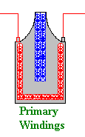
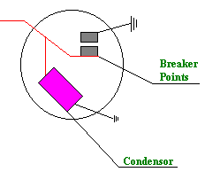
DIAGRAM OF PRIMARY CIRCUIT

Slide 16
PARTS OF SECONDARY CIRCUIT
1) Secondary Windings - Thousands of loops of very thin wire. Magnetic field goes through these to create high voltage.
2) Coil Wire - Carries all of the high voltage out of coil to the distributor cap.
3) Distributor Cap - Distributes the high voltage to plug wires. Creates the firing order for cylinders.

Slide 17
SECONDARY COMPONENTS Cont.
4) Rotor - Receives high voltage from cap and spins to distribute spark to each plug wire.
5) Spark plug wire - Carries high voltage from cap to spark plug
6) Spark plug - Provides an air gap for spark to jump and ignite fuel mixture.

Slide 18


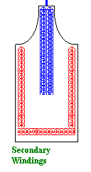



DIAGRAM OF SECONDARY CIRCUIT

Slide 19
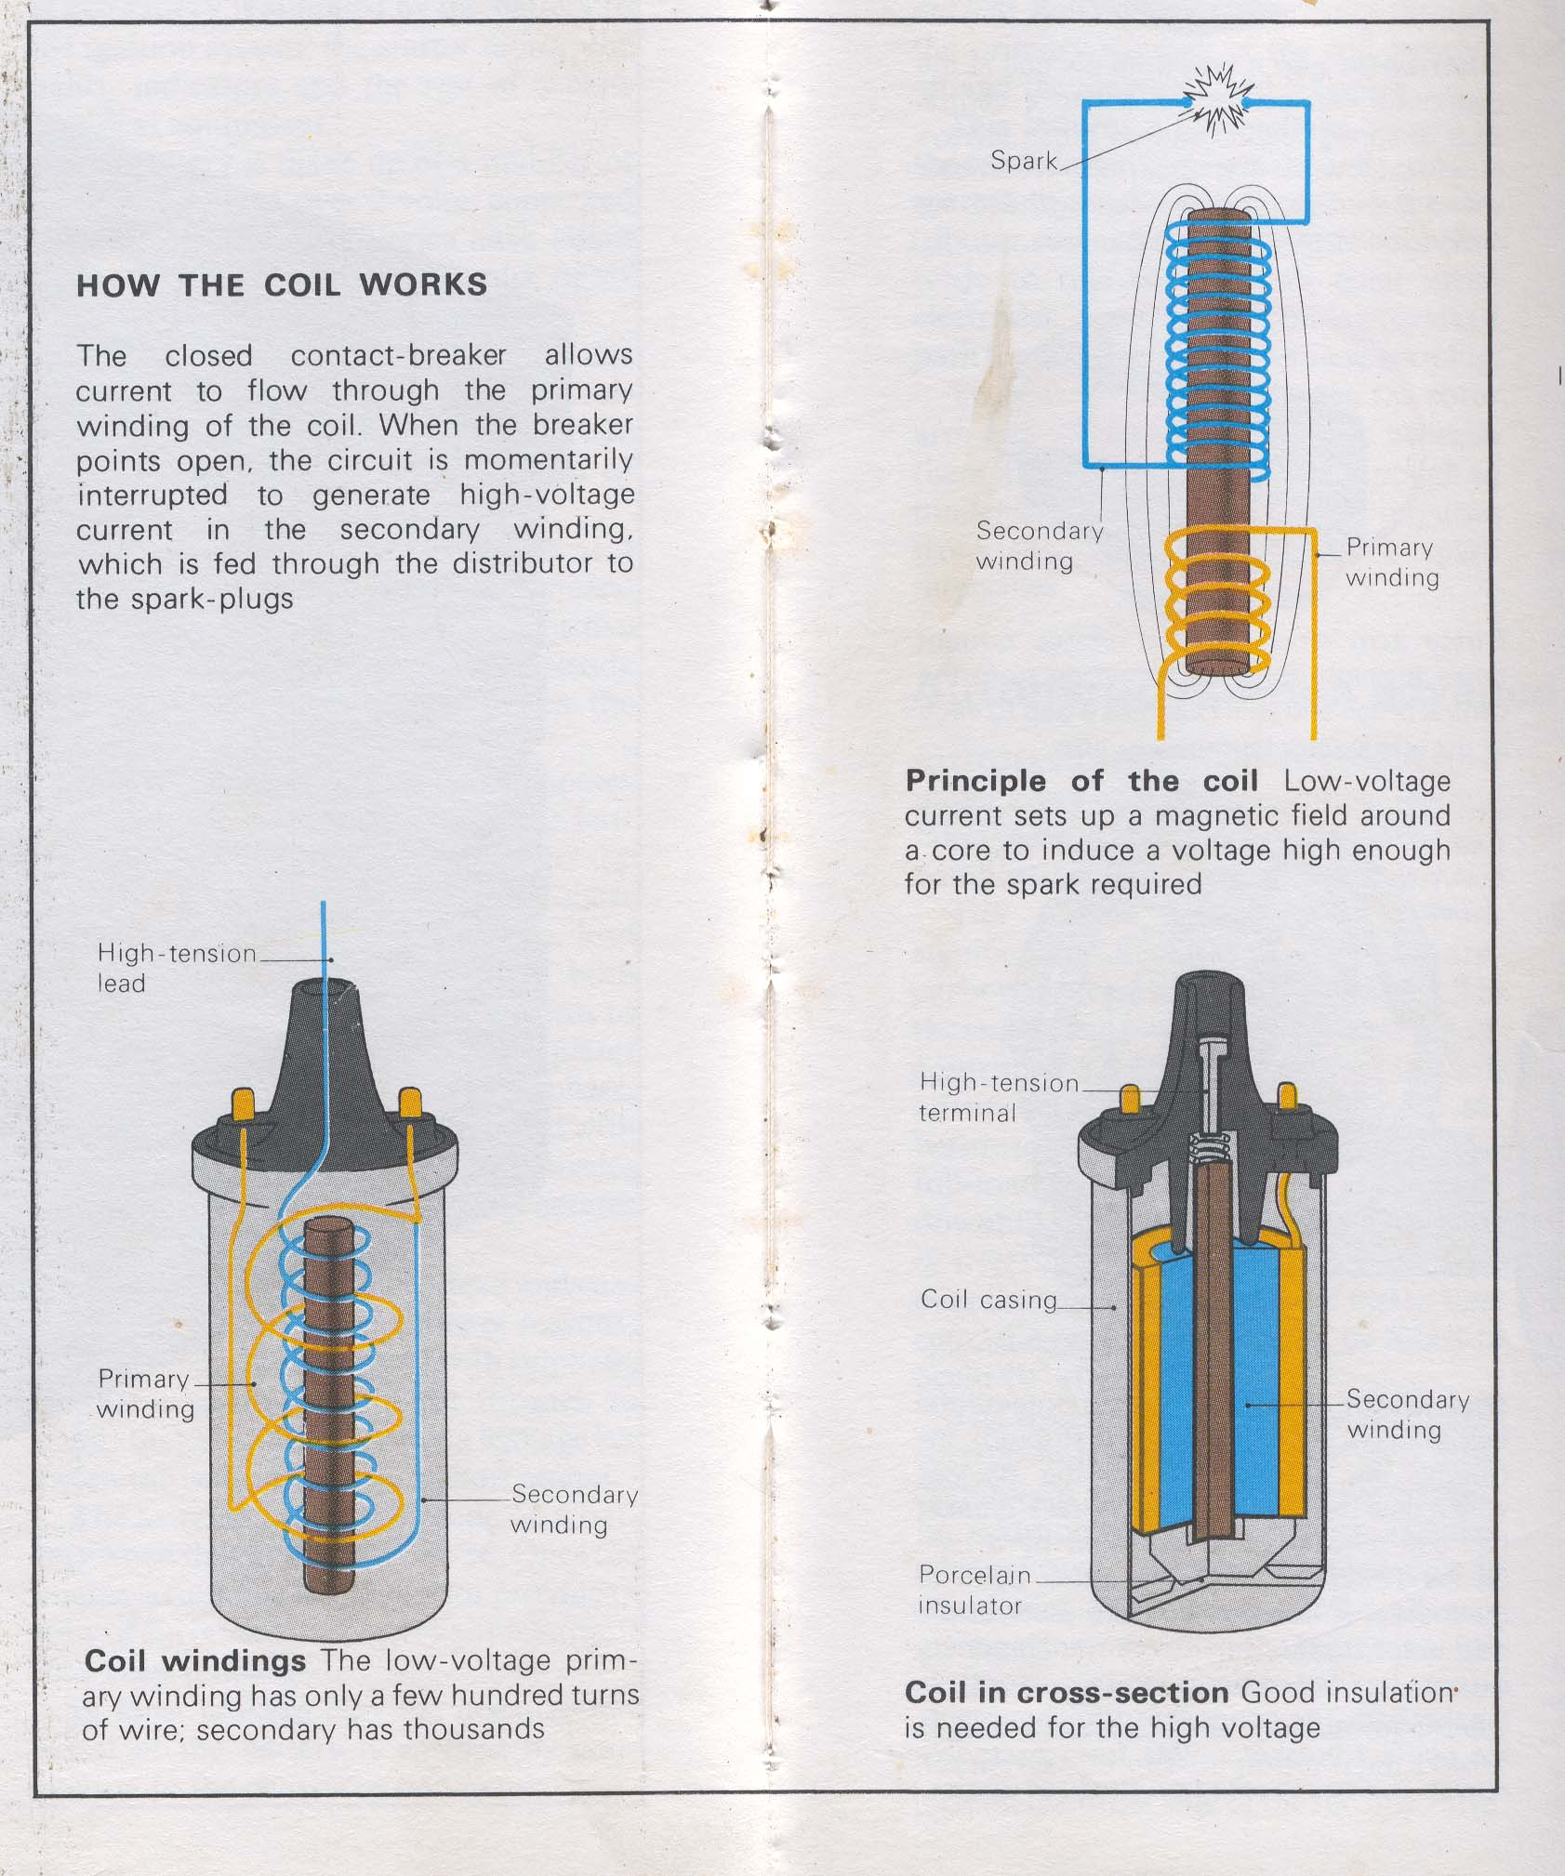
IGNITION COIL
It steps up the battery voltage to high voltage required at the spark plug to ignite air-fuel mixture.
The high voltage available is 25 – 30 kV and energy stored in the coil is 60 – 120 mJ.

Slide 20
DISTRIBUTOR
This consists of a cap containing the connections for the high-tension leads and the fixed electrodes, a rotor, a shaft with a cam to operate the contact breaker, the contact breaker unit with points, the centrifugal and vacuum advance and retard mechanisms, the condenser and the distributor body.

Slide 21
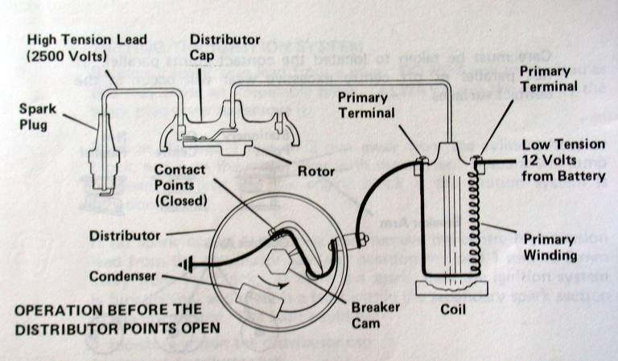
CB POINTS CLOSED
When the CB points close, a current flows from battery terminal to ignition switch and to primary winding and the CB to earth. This builds up a magnetic field in the primary winding. As this magnetic field is being built up, a self-induced voltage develops in the primary winding in the opposite direction to the applied voltage, so that rapid build-up of the magnetic field is delayed.

Slide 22
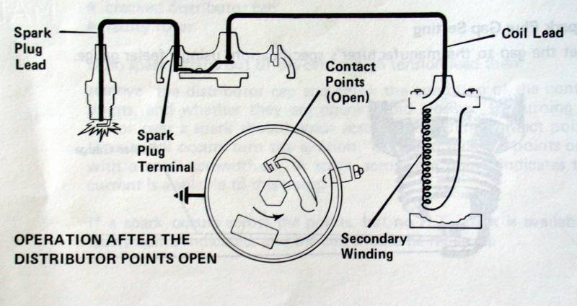
CB POINTS OPEN
When CB points open, the magnetic field attempts to decay very rapidly, thereby inducing a voltage of approx. 200 to 400 V in the primary winding, this time with the same direction of flow as the battery voltage previously applied. The self-induced voltage prevents the magnetic field from breaking down too rapidly, and in any case a spark would form at the CB points were it not for the presence of the condenser.

Slide 23
CONDENSER
It prevents a spark from occurring at the CB points as they open, and therefore ensures that the primary circuit is interrupted accurately. This allows the magnetic field to decay quickly, so that a high ignition voltage is generated in the secondary winding. As a result, CB points are not exposed to severe loads.

Slide 24
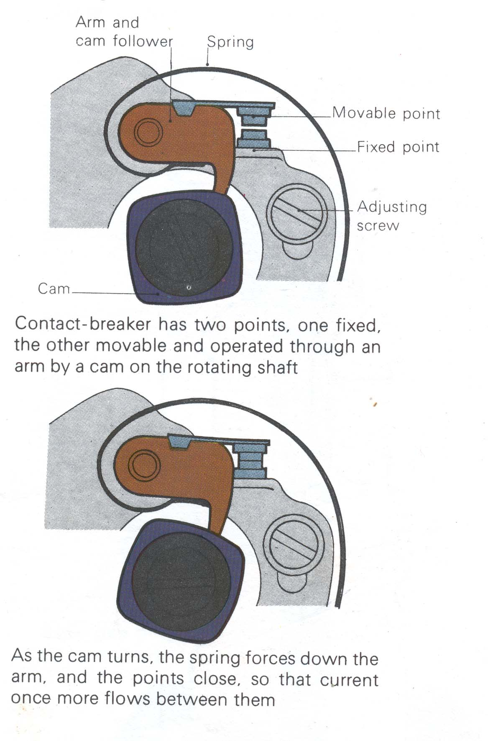
CONTACT BREAKER POINTS
C.B. points gap:
4 cylinder engine: 0.30 mm
6 cylinder engine: 0.25 mm
A smaller CB points gap retards the ignition.
A large CB points gas advances the ignition.

Slide 25
SPARK TIMING
Spark should occur after compression stroke with piston at TDC.
This will change as engine speeds up because fuel can only burn at one rate of speed.
Piston could move faster than fuel burns, which means piston could be gone from TDC before fuel can push down on piston.

Slide 26
TWO WAYS TO ADVANCE TIMING
Vacuum advance - uses vacuum to pull on the breaker plate and cause points to open sooner.
Centrifugal advance - uses centrifugal force to move some weights and cause shaft to move ahead of rotation and open points sooner.

Slide 27
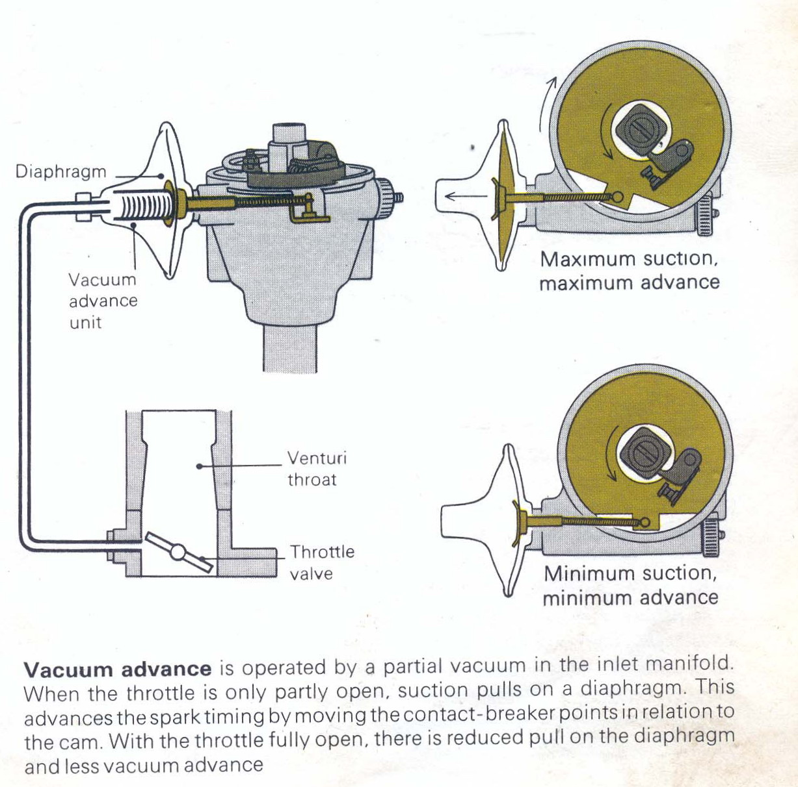
VACUUM ADVANCE
This mechanism varies ignition timing in accordance with the load on the engine. It normally takes effect in the part-load operating mode only.

Slide 28
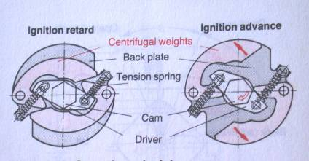
CENTRIFUGAL ADVANCE
A mechanical centrifugal-advance mechanism is employed to produce the advance ignition on engine speed. As the speed increases, the centrifugal force on the weights moves them out against the spring tension. This movement causes the cam assembly to move ahead.
Notes:
The contact breaker cam can move on the distributor shaft. As speed increases, the centrifugal weights of the advance mechanism are drawn outwards, and move the contact breaker cam round the distributor shaft in its direction of rotation, so that the contact breaker points are opened earlier.

Slide 29
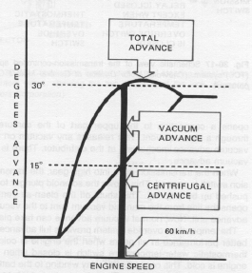
ADVANCE TIMING
Centrifugal, and vacuum advance work together to modify the advance curve of the ignition system to maximize fuel economy, emissions, and power.

Slide 30
Three terms that refer to the amount of time the points are closed.
Coil saturation time. Time coil has to build magnetic field while points are closed.
Cam angle - number degrees of cam rotation when points are closed.
Dwell - amount of time coil has to build up a magnetic field. Points closed. Measured in degrees of distributor cam rotation.

Slide 31
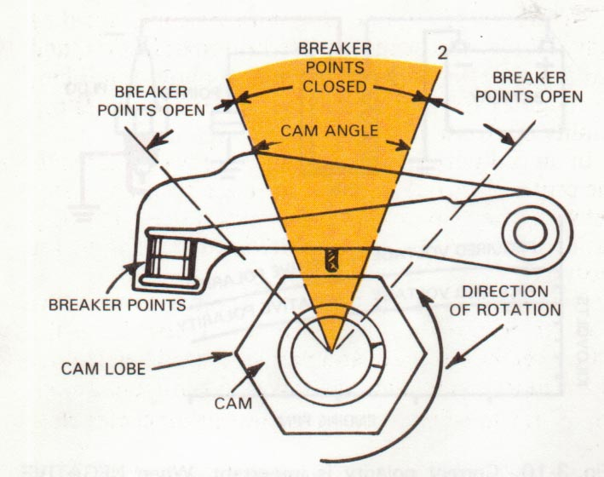
DWELL ANGLE
The dwell angle in contact breaker systems determines the time allowed for current to flow through the primary winding and establish the necessary magnetic field.
Notes:
The dwell angle is the number of degrees of rotation of the cam/distributor during which the points are closed. During each rotation of the cam/distributor, the points must open and close once for each cylinder. The points must stay closed long enough to allow the coil primary current to reach an acceptable value, and open long enough to discharge and produce a spark.
The term dwell angle is not use in today's ignition system since in an electronic circuit there is no angle. Instead the time the primary circuit is charging is basically referred to as "charging time" or in some instances, "closed time".

Slide 32
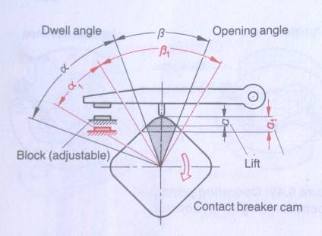
DWELL ANGLE
A smaller CB points gap increases the dwell angle and retards the ignition.
A larger CB points gap reduces the dwell angle and advances the ignition
Notes:
The angle of distributor shaft rotation while the contact breaker points are closed is called the dwell angle α.
The angle of distributor shaft rotation while the contact breaker points are open is called the opened angle β.
Angular ignition spacing γ is the sum of dwell angle α and opened angle β.
γ = α + β. It is common practice to quote the dwell angle as a percentage of angle γ.

Slide 33
Dwell or Cam angle varies with engine size
  4 cylinder = 50 to 60 degrees of dwell
  6 cylinder = 37 to 47 degrees of dwell
  8 cylinder = 28 to 32 degrees of dwell

Slide 34
POINT GAP vs. DWELL
If point gap is too big the dwell will be too small
If point gap is too small the dwell is too big
If dwell is small the point gap is large.
If dwell is too large the point gap is small

Slide 35
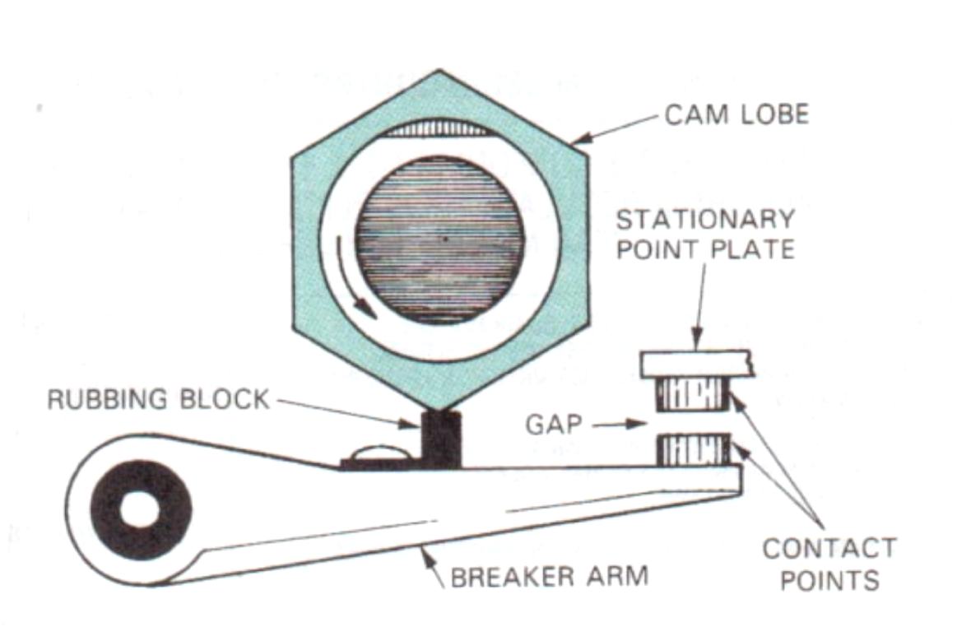
C.B. POINT GAP

Slide 36
SPARKS PLUGS
It is used to introduce the ignition energy into the combustion chamber, and to initiate combustion of the air-fuel mixture by generating an electric spark between the electrodes.
The occurrence of arc takes place at voltages up to 20 kV and above.
The spark plug is subjected to very high electrical, mechanical, chemical and thermal stresses.

Slide 37
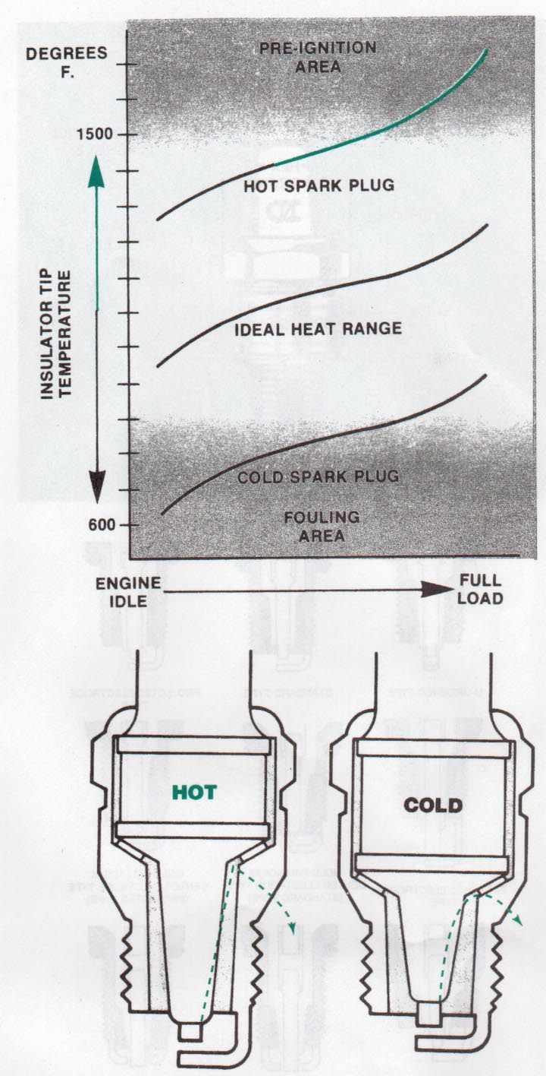
SPARK PLUG HEAT RANGE
Heat range. It is the temperature the spark plug is designed to run at.
It is determined by the length of the insulator tip.
Longer insulator tip will cause plug to run hotter.

Slide 38
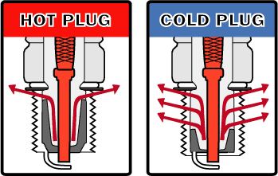
The difference between a "hot" and a "cold" spark plug is in the shape of the ceramic tip
Some cars require a hot plug. This type of plug is designed with a ceramic insert that has a smaller contact area with the metal part of the plug. This reduces the heat transfer from the ceramic, making it run hotter and thus burn away more deposits. Cold plugs are designed with more contact area, so they run cooler.

Slide 39
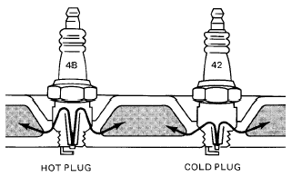
SPARK PLUG – HEAT RANGE
If the heat path is long, the plug will run hot.
If the heat path is short, the plug will run much cooler. However, if the plug runs too cool, sooty carbon will deposit on the insulator around the center electrode.
The heat range is correct if the spark plug rapidly reaches its self cleaning temperature of 400 to 500ºC during operation, but does not exceed 850ºC at full load.
Notes:
Spark plugs with various heat ranges are used to allow for the different thermal stresses present in engines of different types and designs.
The lower the heat range index of a spark plug, the higher its resistance to auto-ignition.
The higher the heat range index of the spark plug, the lower its resistance to auto-ignition, and the higher its resistance to fouling.
The shape of the insulator base determines the spark plug’s heat rating:
A long insulator base means poorer heat dissipation, so that the spark plug itself runs hotter and has a lower heat rating.
A short insulator base dissipates heat better, so that the plug remains relatively cool and is regarded as having a higher heat rating.

Slide 40
ELECTRODE GAP
Application | Gap, mm
Customary vehicle engines with battery ignition systems and mixture adaptation (λ = 1) | 0.7 – 0.9
Extremely lean-running engine design | 1.0 – 1.2
Small engines with magneto ignition systems | 0.5
Engines with a high compression ratio (e.g. racing engines, gas engines) | 0.3 – 0.5

Slide 41
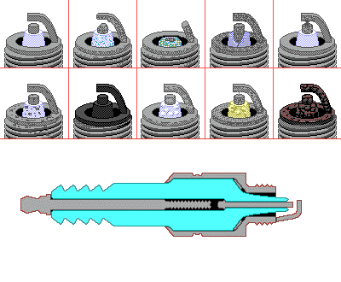
CONDITION OF SPARK PLUGS
Source: http://www.autoshop-online.com/auto101/leadfouling.html

Slide 42
IGNITION VOLTAGE
Major factors which influence the ignition voltage are not only the electrode gap but also the shape and temperatures of the electrodes and the condition of the gap between the electrodes.
Two spark plugs with the same electrode gap may operate differently: one spark plug may continue to arc under favorable condition, while the other spark plug may misfire at the same time.
Under normal operating conditions the ignition voltage is 5,000 to 17,000 V.
With the engine cold, a lean mixture and a wide electrode gap, the voltage can increase to over 25,000 V (such as in the case of sudden, complete opening of the throttle valve at idle).

Slide 43
MAGNETO-IGNITION SYSTEM
This system is extensively used in mopeds, scooters, three wheelers, motor cycles etc.
Magneto ignition systems differ from battery systems by powering the coil directly from a permanent magnet generator or magneto, rather than a stored battery source. The generator requires some external, mechanical action to start, often a crank or pedal of some kind.
The main components of the system are: magnets, armature assembly, breaker points, condenser, distributor and spark plug.

Slide 44
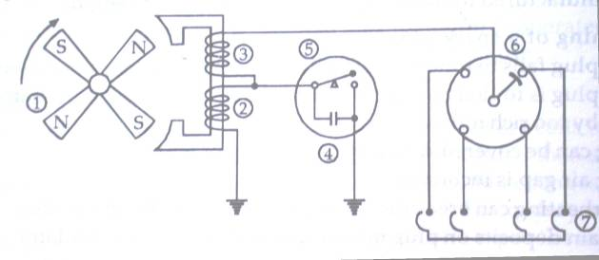
MAGNETO IGNITION SYSTEM
1- Rotating magnet assembly, 2 & 3 Primary & Secondary winding (fixed armature), 4-Condenser, 5-CB points, 6-Rotor, 7-Spark plugs
Notes:
The magneto ignition system consists of a fixed armature having primary and secondary windings and a rotating magnetic assembly which is driven by the engine. When the magneto rotates, current flows in the primary winding. The secondary winding gives high voltage current to the distributor, which distributes it to the respective spark plugs.
The magneto may be either rotating armature type or rotating magnet type. In rotating armature type magneto, the armature carrying the primary and secondary windings and the condenser, rotate between the poles of a stationary horse shoe magnet.

Slide 45
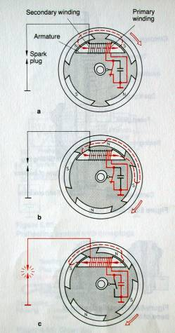
MAGNETO IGNITION SYSTEM
When CB points are closed, a current flows in the primary winding of the ignition armature and generates a magnetic field (Fig a, b).
The points are opened at the moment when the current flow is at its greatest, that is to say when the magnetic field in the primary winding has reached a maximum. This is the case when the pole wheel position causes the direction of the magnetic field in the ignition armature to change suddenly (Fig. c).
This sudden reversal of the magnetic field induces a high voltage in the secondary winding.

Slide 46
S.N. | Aspects | Battery ignition system | Magneto ignition system
1 | Current for primary circuit | Obtained from battery | Generated by the magneto
2 | Starting | Difficult to start when battery is in discharged condition | No problem of battery discharge
3 | Maintenance problems | More, due to battery | Less, due to absence of battery
4 | Intensity of spark at low speed | Good | Poor
5 | Efficiency | Efficiency of the system decreases with the reduction in spark intensity as the engine speed increases | Efficiency of the system improves as the engine speed increases due to high intensity spark
6 | Cost | Less | More
7 | Space occupied | More | Less
8 | Applications | In cars and light commercial vehicles | In racing cars and two wheelers, aircraft etc.
Source: Rajput, R.K., 2006, A textbook of automobile engineering, Laxmi Publications (P) Ltd, New Delhi

Slide 47
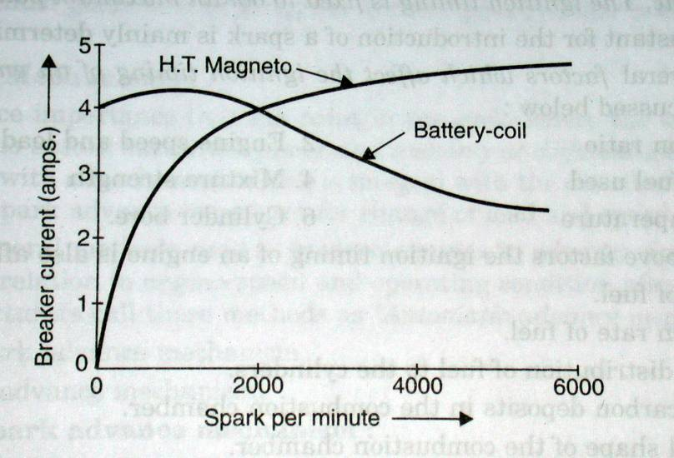
CURRENT vs RPM

Slide 48
DRAWBACKS OF CB POINTS IGNITION SYSTEM
The wear of contact breaker points (short maintenance intervals)
Decrease in available voltage as engine speed increases due to limitations in the current switching capability of the of the breaker system
Decreasing time available to build up the primary coil stored energy

Slide 49
ELECTRONIC IGNITION SYSTEM
Electronic ignition system meets the following requirements of modern engines:
  The need for much reduced ignition system maintenance
  Extended spark plug life
  Improved ignition of lean and dilute mixtures
  Increased reliability

Slide 50
ELECTRONIC IGNITION SYSTEMS
The primary circuit in the CB points system is opened and closed by CB points.
In the electronic system, the primary circuit is opened and closed by the electronic control unit (ECU).
The secondary circuits are practically the same for the two systems.
One advantage of electronic system is higher voltage – up to 47,000 V – spark plugs with wider gaps can be used. This results in a longer spark which can ignite leaner air-fuel mixtures – better fuel economy and lower emissions.
There is no mechanical advance mechanisms, instead the spark timing is adjusted electronically.

Slide 51
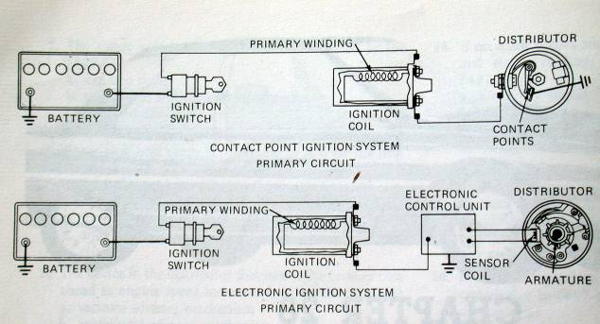
CONTACT POINT IGNITION SYSTEM vs ELECTRONIC IGNITION SYSTEM

Slide 52
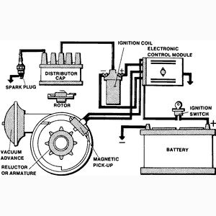
Typical electronic ignition system
Source: http://www.procarcare.com/icarumba/resourcecenter/encyclopedia/icar_resourcecenter_encyclopedia_ignition.asp
Notes:
Electronic ignition systems differ from conventional ignition systems in the distributor component area. Instead of a distributor cam, breaker plate, points, and condenser, an electronic ignition system has an armature (called by various names such as a trigger wheel, reluctor, etc.), a pickup coil (stator, sensor, etc.), and an electronic control module.

Slide 53
Working of electronic ignition system
Essentially, all electronic ignition systems operate in the following manner: With the ignition switch turned on, primary (battery) current flows from the battery through the ignition switch to the coil primary windings.
Primary current is turned on and off by the action of the armature as it revolves past the pickup coil or sensor. As each tooth of the armature nears the pickup coil, it creates a voltage that signals the electronic module to turn off the coil primary current. A timing circuit in the module will turn the current on again after the coil field has collapsed.
When the current is off, however, the magnetic field built up in the coil is allowed to collapse, which causes a high voltage in the secondary windings of the coil. It is now operating on the secondary ignition circuit, which is the same as in a conventional ignition system.

Slide 54
Components of electronic ignition system
TRIGGER WHEEL—The trigger wheel, also known as a reluctor, pole piece, or armature, is connected to the upper end of the distributor shaft. The trigger wheel replaces the distributor cam. Like the distributor cam lobes, the teeth on the trigger wheel equal the number of engine cylinders.
PICKUP COIL—The pickup coil, also known as a sensor assembly, sensor coil, or or magnetic pickup assembly, produces tiny voltage surges for the ignition systems electronic control unit. The pickup coil is a small set of windings forming a coil.
ELECRTONIC CONTROL UNIT AM-PLIFIER—The ignition system electronic control unit amplifier or control module is an “electronic switch” that turns the ignition coil primary current ON and OFF. The ECU performs the same function as the contact points. The ignition ECU is a network of transistors, capacitors, resistors, and other electronic components sealed in a metal or plastic housing. The ECU can be located (1) in the engine compartment, (2) on the side of the distributor,(3) inside the distributor, or (4) under the vehicle dash. ECU dwell time (number of degrees the circuit conducts current to the ignition coil) is designed into the electronic circuit of the ECU and is NOT adjustable.

Slide 55
ADVANTAGES OF ELECTRONIC IGNITION SYSTEM
More precise adjustment of ignition timing
Better emission control
Better fuel economy
Better engine performance

Slide 56
Electronic ignition.exe

Slide 57
CONCLUSIONS
Battery ignition system is commonly used because of its combined cheapness, convenience of maintenance, attention and general suitability.
The magneto ignition is an efficient, reliable, self contained unit, which is often preferred for aircraft engines because storage batteries are heavy and troublesome and two wheeler’s engine.
Modern automobiles uses electronic ignition system because of precise ignition timing, better fuel economy, better emission control and improved engine performance.

Slide 58
QUIZ
1. If the dwell is 50 degrees, but it should be 30 degrees, what is wrong with the point gap?
2. If the point gap is 0.024”, but should be 0.016”, what type of dwell reading will there be?
3. What is dwell?
4. What are the other two names that refer to the same thing as dwell?
5. Why must the spark timing be advanced?
6. What two things advance the timing?

